Slide 1
NORMALIZATION

Slide 2
An Example

Slide 3
Normalisation Example
We have a table representing orders in an online store
Each row represents an item on a particular order
Primary key is
{Order, Product}
Columns
  Order
  Product
  Quantity
  UnitPrice
  Customer
  Address

Slide 4
Functional Dependencies
Each order is for a single customer:
  Order → Customer
Each customer has a single address
  Customer → Address
Each product has a single price
  Product → UnitPrice
As Order → Customer and Customer → Address
  Order → Address

Slide 5
2NF Solution (I)
First decomposition
  First table
  Second table
Order | Product | Quantity | UnitPrice
Order | Customer | Address

Slide 6
2NF Solution (II)
Second decomposition
  First table
  Second table
  Third table
Order | Product | Quantity
Order | Customer | Address
Product | UnitPrice

Slide 7
3NF
In second table
  Customer → Address
Split second table into
Order | Customer | Address
Order | Customer
Customer | Address

Slide 8
Normalisation to 2NF
Second normal form means no partial dependencies on candidate keys
  {Order} → {Customer, Address}
  {Product} → {UnitPrice}
To remove the first FD we project over
  {Order, Customer, Address} (R1)
and
{Order, Product, Quantity, UnitPrice} (R2)

Slide 9
Normalisation to 2NF
R1 is now in 2NF, but there is still a partial FD in R2
  {Product} → {UnitPrice}
To remove this we project over
{Product, UnitPrice} (R3)
and
{Order, Product, Quantity} (R4)

Slide 10
Normalisation to 3NF
R has now been split into 3 relations - R1, R3, and R4
  R3 and R4 are in 3NF
  R1 has a transitive FD on its key
To remove
  {Order} → {Customer} → {Address}
we project R1 over
  {Order, Customer}
  {Customer, Address}

Slide 11
Normalisation
1NF:
  {Order, Product, Customer, Address, Quantity, UnitPrice}
2NF:
  {Order, Customer, Address}, {Product, UnitPrice}, and {Order, Product, Quantity}
3NF:
  {Product, UnitPrice}, {Order, Product, Quantity},
  {Order, Customer}, and {Customer, Address}

Slide 12
An Example

Slide 13
FIRST Normal Form (1NF)
For a table to be in the first normal form, it must meet the following criteria:
a single cell must not hold more than one value (atomicity)
there must be a primary key for identification
no duplicated rows or columns
each column must have only one value for each row in the table

Slide 14
employee_id | name | job_ code | job | state_ code | home_ state
E001 | Alice | J01 | Chef | 26 | Michigan
E001 | Alice | J02 | Waiter | 26 | Michigan
E002 | Bob | J02 | Waiter | 56 | Wyoming
E002 | Bob | J03 | Bartender | 56 | Wyoming
E003 | Alice | J01 | Chef | 56 | Wyoming
All the entries are atomic and there is a composite primary key (employee_id, job_code) so the table is in the first normal form (1NF).

Slide 15
Second Normal Form (2NF)
The 1NF only eliminates repeating groups, not redundancy. That’s why there is 2NF.
A table is said to be in 2NF if it meets the following criteria:
it’s already in 1NF
has no partial dependency. That is, all non-key attributes are fully dependent on a primary key.

Slide 16
Second Normal Form (2NF)
Employees Table
employee_id | name | state_code | home_state
E001 | Alice | 26 | Michigan
E002 | Bob | 56 | Wyoming
E003 | Alice | 56 | Wyoming
EMP_Jobs Table
Jobs Table
employee_id | job_code
E001 | J01
E001 | J02
E002 | J02
E002 | J03
E003 | J01
job_code | job
J01 | Chef
J02 | Waiter
J03 | Bartender

Slide 17
Second Normal Form (2NF)
Employees Table
employee_id | name | state_code | home_state
E001 | Alice | 26 | Michigan
E002 | Bob | 56 | Wyoming
E003 | Alice | 56 | Wyoming
home_state is now dependent on state_code. So, if you know the state_code, then you can find the home_state value.
To take this a step further, we should separate them again to a different table to make it 3NF.

Slide 18
Third Normal Form (3NF)
Employees Table
employee_id | name | state_code
E001 | Alice | 26
E002 | Bob | 56
E003 | Alice | 56
States Table
state_code | home_state
26 | Michigan
56 | Wyoming
Now our database is in 3NF.

Slide 19
Third Normal Form (3NF)
EMP_Jobs Table
Jobs Table
employee_id | job_code
E001 | J01
E001 | J02
E002 | J02
E002 | J03
E003 | J01
job_code | job
J01 | Chef
J02 | Waiter
J03 | Bartender
Now our database is in 3NF.

Slide 20
An Example

Slide 21

The above table is in the first normal form but not in the second normal form. In this table, the concatenation of Con_id and Order_id is the primary key. This table is not in the second normal form, because partial dependencies are present on the primary key. Con_name is only dependent on Con_id and Order_name is only dependent on Order_id. There is no connection between Sale and Con_name. To convert this table into 2NF, you need to divide this table into three tables.

Slide 22
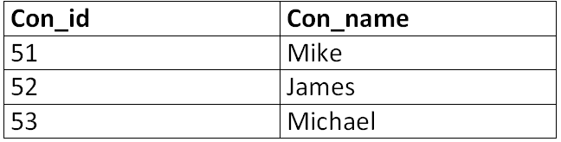

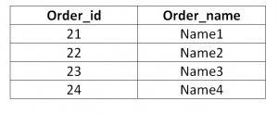
Consumer_detail
sale_detail
order_detail

Slide 23
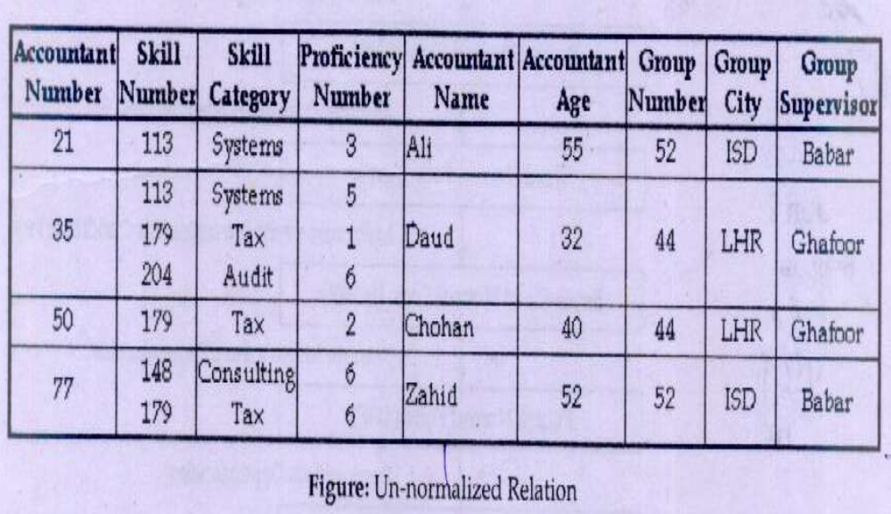

Slide 24
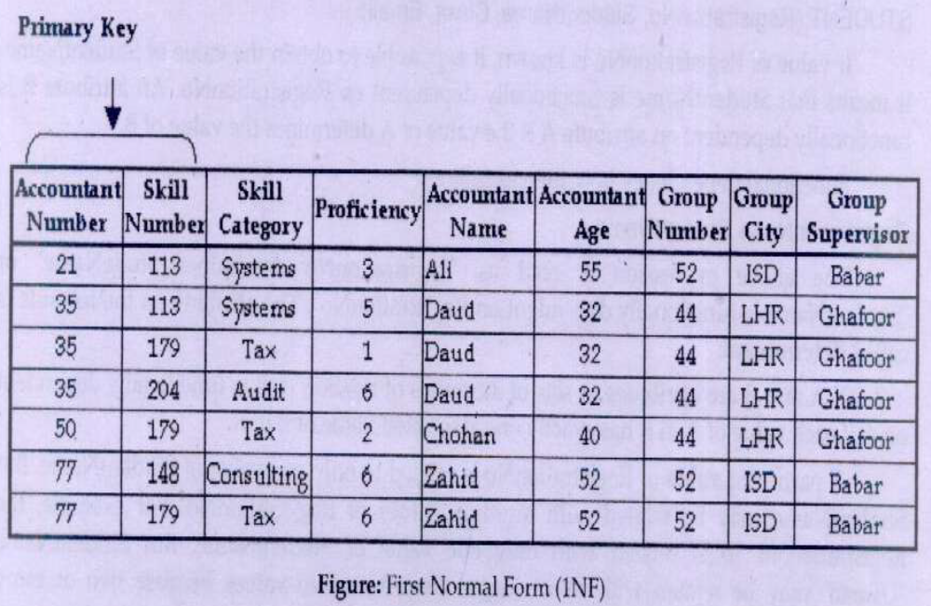

Slide 25
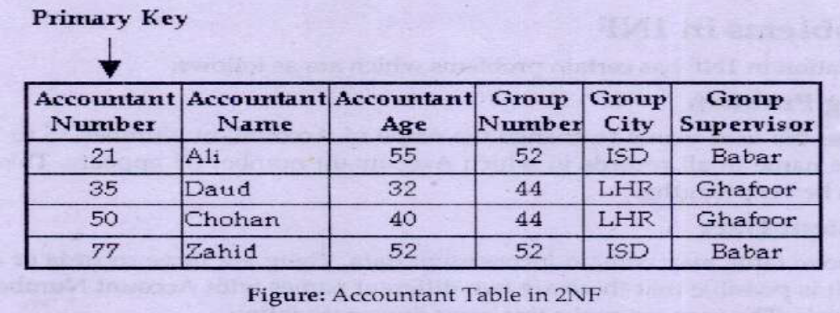
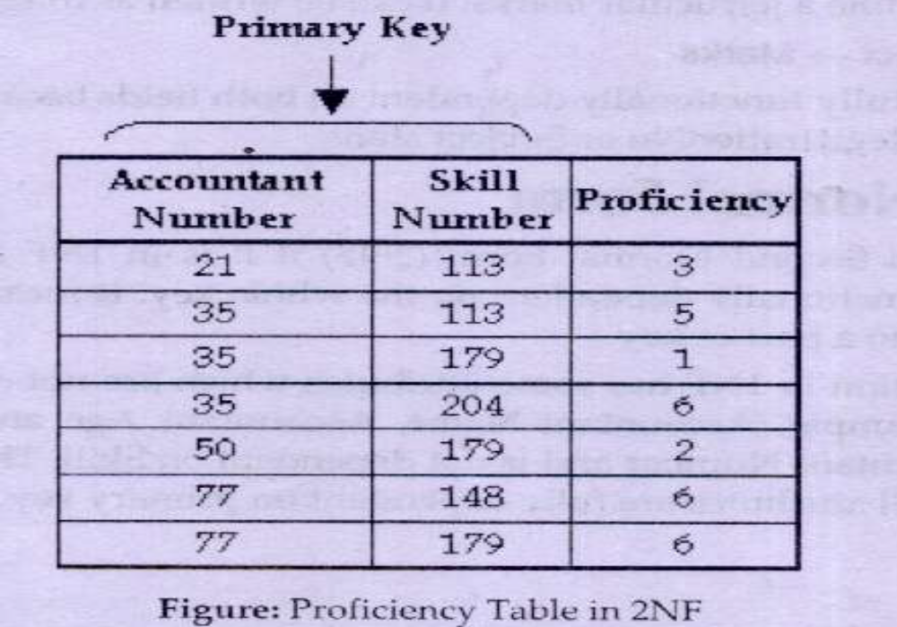
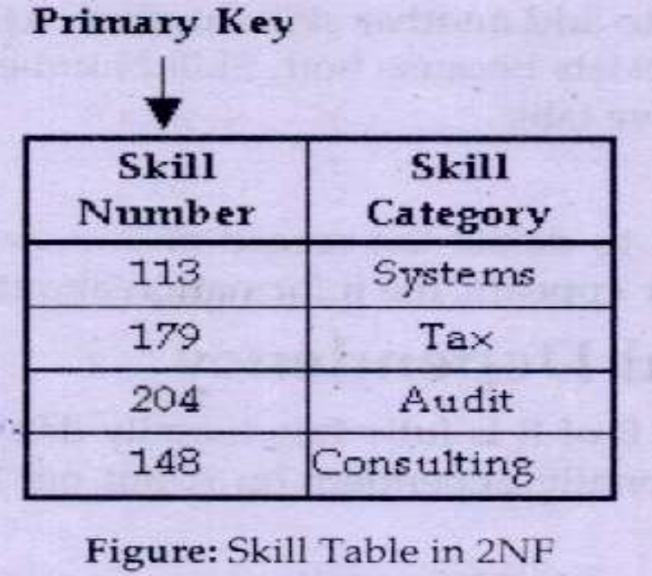

Slide 26
